Slide 1
How to Create
a
Constellation
5-ESS1-1
Support an argument that differences in the apparent brightness of the sun compared to other stars is due to their relative distances from the Earth.

Slide 2
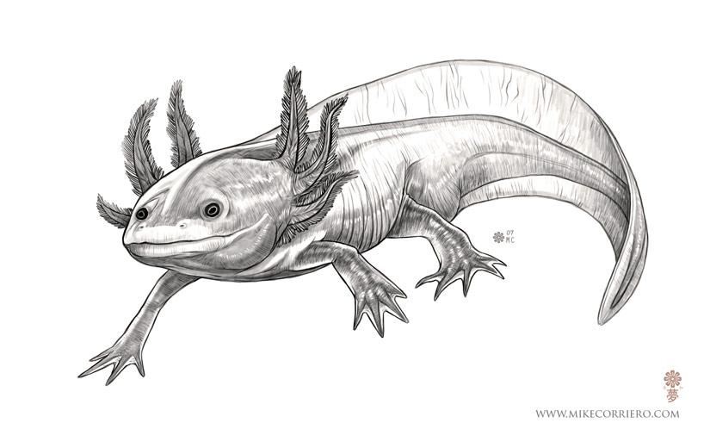
Step 1
Choose image: axolotl salamander

Slide 3
Step 2
Decide where to place stars:

Slide 4
Step 3
Place image with stars over black construction paper and transfer the placement of the stars to the black construction paper. I used a pencil to poke through the paper and make a mark on the construction paper.

Slide 5
Step 4
Connect your stars and name your constellation. (ie. salamander in latin)
Salamandra

Slide 6
Step 5
Name your stars (latin is tradition among constellations)
Sachi
Amabel
Dacey
Amadeus
Sabella

Slide 7
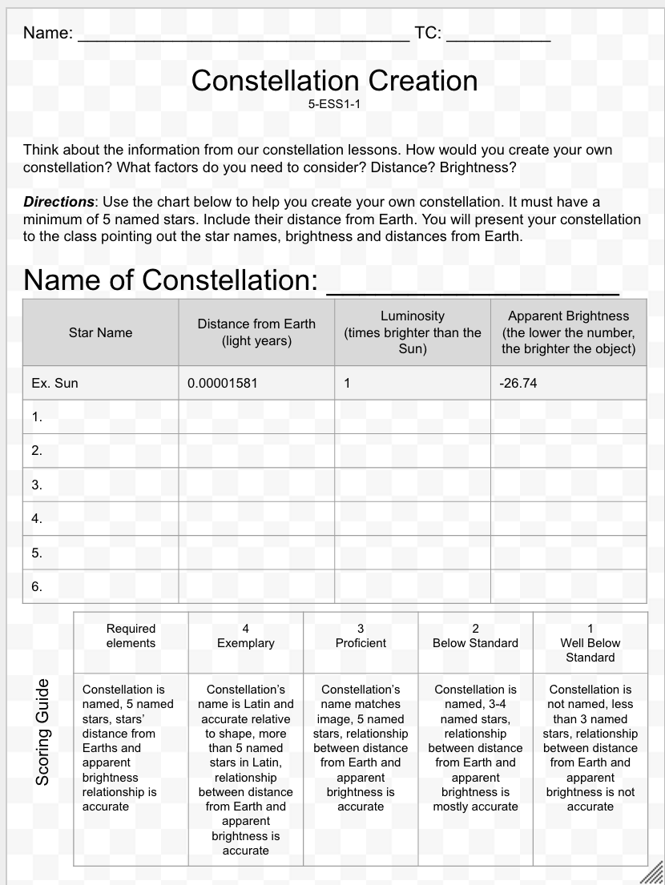
Step 6
Complete worksheet. Make sure the relationship between the distance from Earth and the apparent brightness is accurate.

